Slide 1
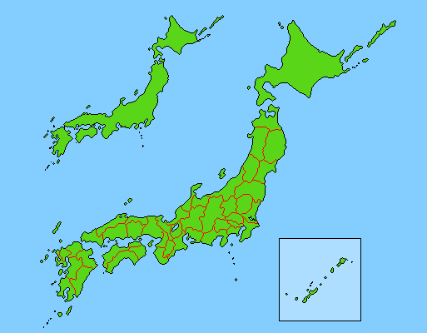
Access Time from Kyoto
Major Destinations
To Kansai International Airport
To Osaka
To Kobe
To Nara
To Tokyo
To Hakata
(by car)
(by train)
(by train)
(by train)
(by train)
(by bullet train)
(by bullet train)
1h55min.
75min.
30min.
60min.
35min.
2h15min.
2h50min.
Kyoto
Osaka Airport
Kobe
Tokyo
New Tokyo
International Airport
Hakata
Osaka
Nara
Kansai International Airport

Slide 3
19 (Sunday)
21 (Tuesday)
22 (Wednesday)
23 (Thursday)
24 (Friday)
25 (Saturday)
AM
PM
AM
PM
AM
PM
AM
PM
AM
PM
AM
PM
TH01
Software Patterns
TH05
Design Patterns
TH09
Requirements
TH12
Java
TH01
Software Patterns
TH02
Testing and Analysis
TH06
UML
TH10
CORBA
TH13
Distributed Architecture
TH03
Objectory Process
TH07
C++
TH11
COTS
TH14
Software Surgery
TH04
Testing and Analysis
TH08
Hypermedia
TF02
Design by Contract
TF01
Experience Factory
TF03
Software Forensics

Slide 4
20
Mon.
AM
Asia Pacific Forum
TH01
TH02
TH03
TH04
TF01
WS03
WS04
WS12
WS06,WS08,WS09
WS02
PM
TH05
TH06
TH07
TH08
21
Tue.
AM
Doctoral Sympo.
TH09
TH10
TH11
TF02
TF03
ICSE98
EXPO
WS10
PM
TH12
TH13
TH14
Reception
22
Wed.
AM
W1
Lessons and Status Reports,
Mini-Tutorial,
Poster & Demo
(TBD)
PM1
W2-1
W2-2
W2-3
PM2
W3-1
W3-2
W3-3
PM3
Welcome Party
23
Thu.
AM
T1
PM1
T2-1
T2-2
T2-3
PM2
T3-1
T3-2
T3-3
PM3
T4
Banquet
24
Fri.
AM
F1
PM1
F2-1
F2-2
F2-3
PM2
F3-1
F3-2
F3-3
PM3
F4
25
Sat.
WS05
WS07,WS11,WS13
26
Sun.

